Slide 1
Computers are fast. Why?
https://tinyurl.com/CPUsFast

Slide 2
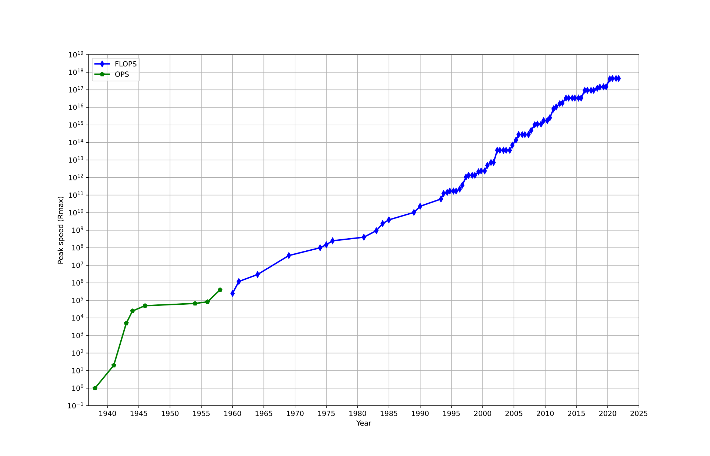
Computers have grown exponentially fast. How?
Source: Top500

Slide 3
Presentation outline
What a computer does, actually.
Boring, widely accessible things that make computers faster
Obscure, nerdy things that make computers* faster

Slide 4
Presentation outline
What a computer does, actually.
Boring, widely accessible things that make computers faster
Obscure, nerdy things that make computers* faster

Slide 5
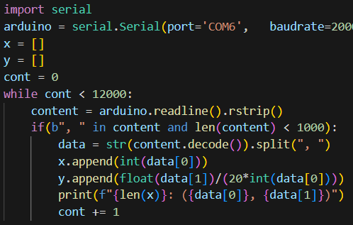
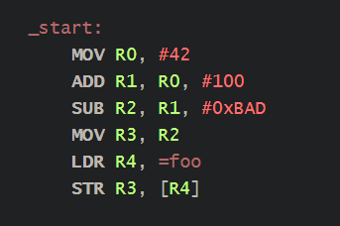
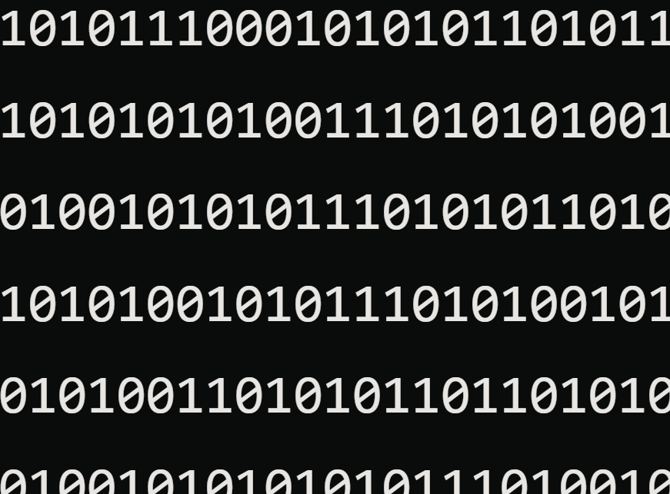
Computers can’t read code.
Compile

Slide 6
Computers execute binary instructions from memory,
one thing at a time
Computer
Memory:
Instructions
Data

Slide 7
Computers work based on a clock
Computer
Memory:
Instructions
Data
Tick
Tock

Slide 8
Presentation outline
What a computer does, actually.
Boring, widely accessible things that make computers faster
Obscure, nerdy things that make computers* faster

Slide 9

Bright colours don’t actually make computers faster

Slide 10

1st trick: have specialized components inside the computer
Graphics card (GPU) is a special type of component that accomplishes certain tasks much quicker than the main processor (CPU)

Slide 11

2nd trick: make the clock tick faster
This means the CPU has a clock that ticks 3.8 billion times a second, which is a million times faster than some 1980s cpus

Slide 12
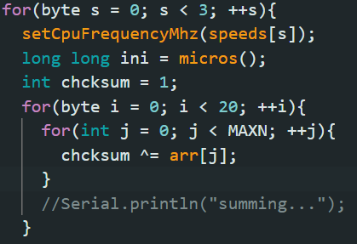
The code for testing the frequency of ESP32

Slide 13
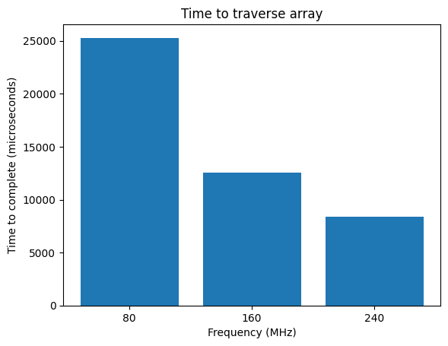
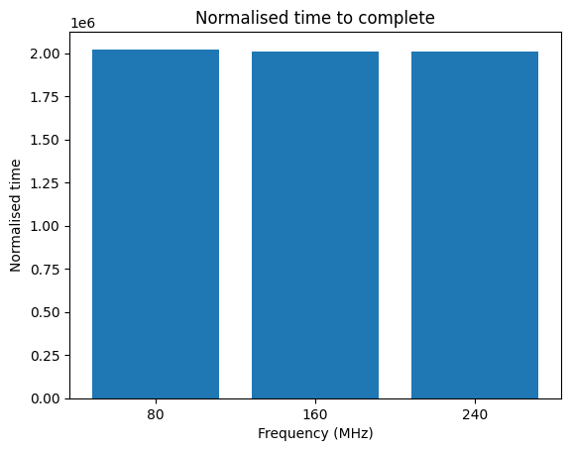
The results are linear, as expected

Slide 14
3rd trick: have several computers inside one
Actually, this CPU is composed of several “CPUs” (cores) eating instructions in parallel

Slide 15
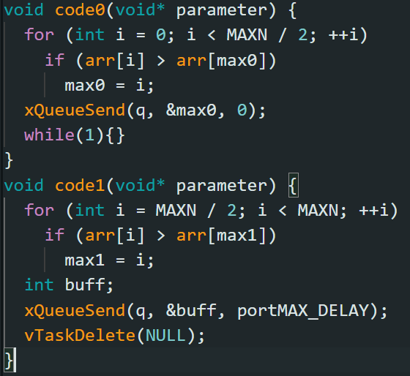
ESP32 (!) code for testing multiple cores (choose max)

Slide 16
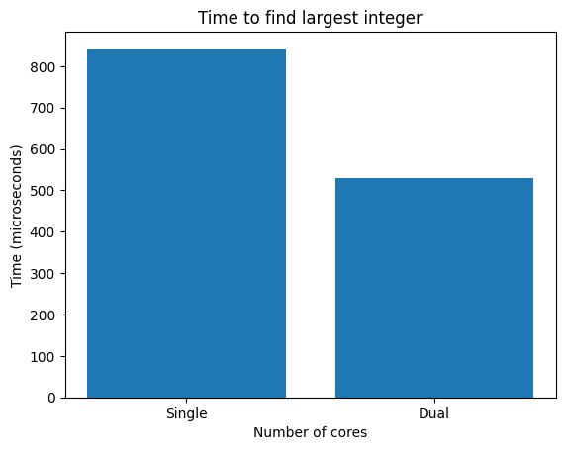
Results are around linear, as expected
NB! Not all tasks can be parallelized

Slide 17
Presentation outline
What a computer does, actually.
Boring, widely accessible things that make computers faster
Obscure, nerdy things that make computers* faster
*From now on, we will focus only on the CPU

Slide 18
4th trick: pipelines let you fully use your CPU
CPU
Tick
Loading and executing are different tasks, but here they wait for each other
Memory
Tock

Slide 19
4th trick: pipelines separate stages, which work together
CPU
Write
Execute
Fetch
1
2
3

Slide 20
4th trick: pipelines separate stages, which work together
CPU
Write
Execute
Fetch
1
2
3

Slide 21
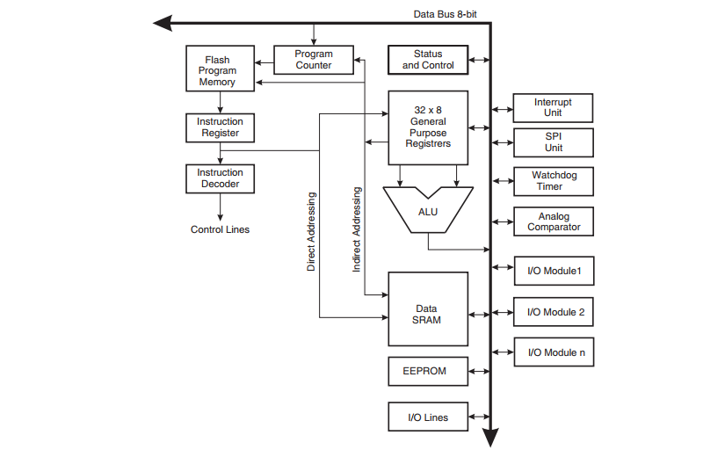
Arduino UNO has a two-stage pipeline

Slide 22
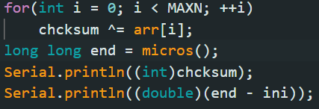
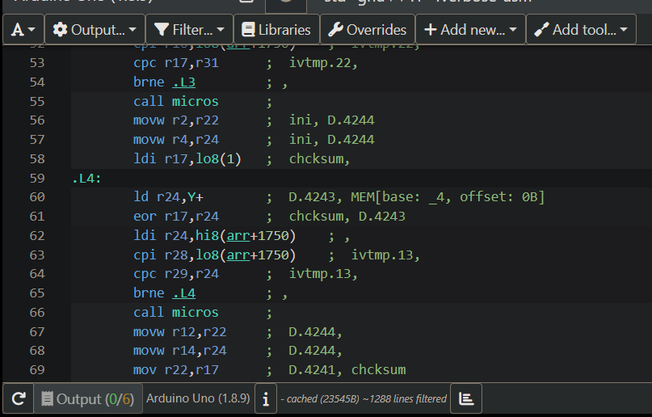
Code to test Arduino fetch/execute pipeline

Slide 23
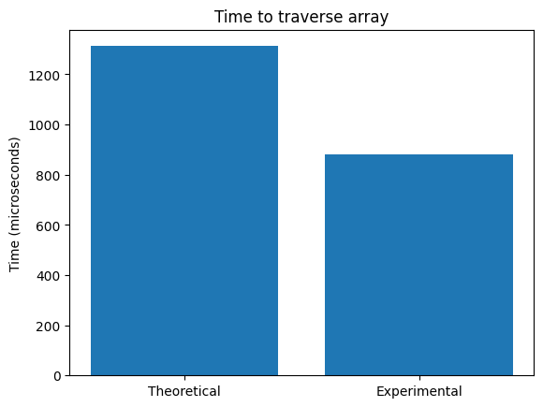
Result of Arduino code shows the pipeline

Slide 24
Cool idea: decode more than one instruction at a time
CPU
Memory:
Instructions
Data

Slide 25
5th trick: superscalar execution is similar to multiprocessing
CPU
Memory:
Instructions
Data
More instructions decoded each cycle
→ More instructions executed each cycle

Slide 26
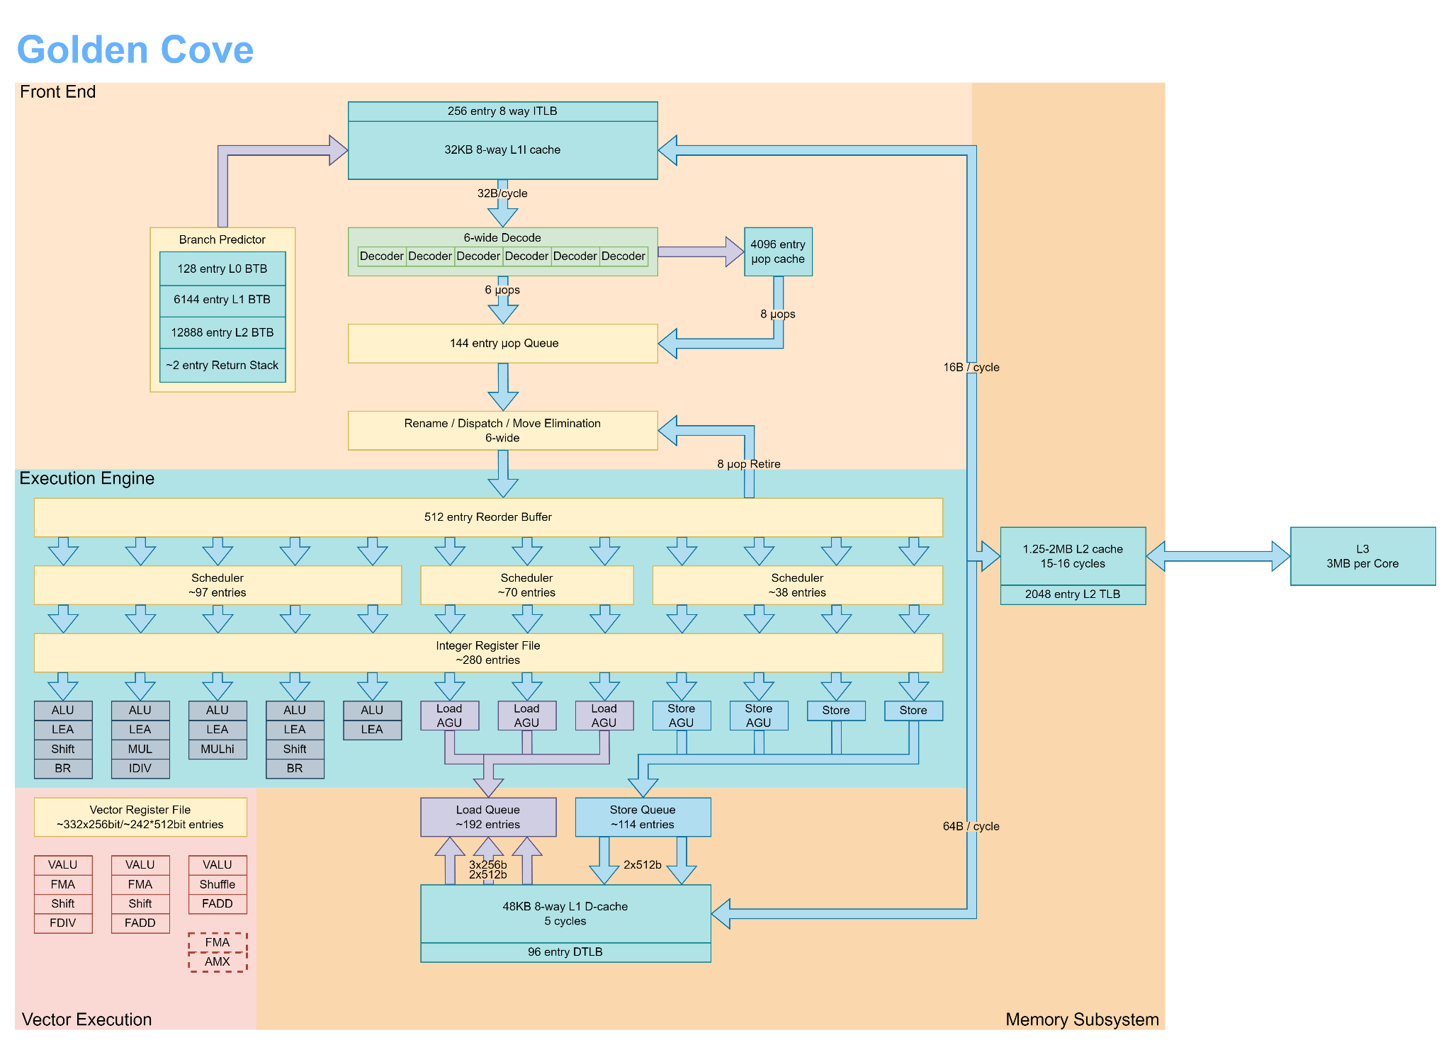
My laptop core design is superscalar

Slide 27
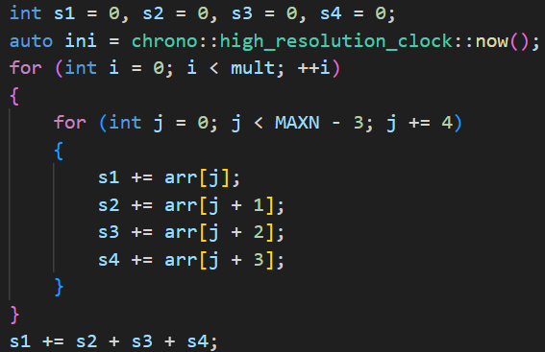
Testing x86 superscalar processing! The code:

Slide 28
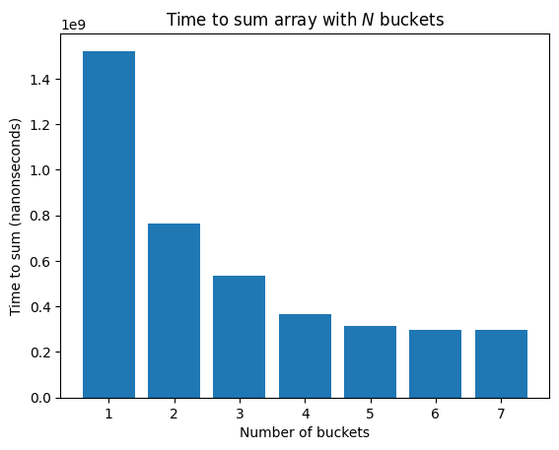
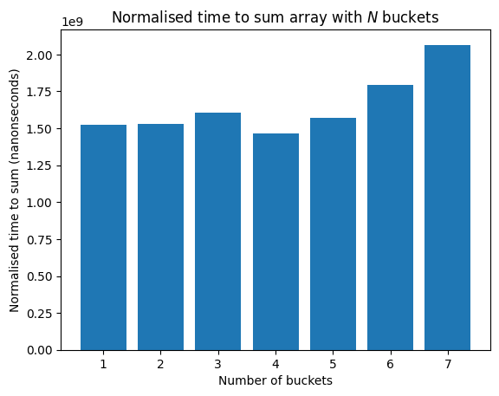
The results show the power of superscalar architectures

Slide 29
6th trick: executing things out of order is smart!
CPU
Memory:
Instructions
Data
Computer avoids pipeline hazards by filling it with other instructions

Slide 30
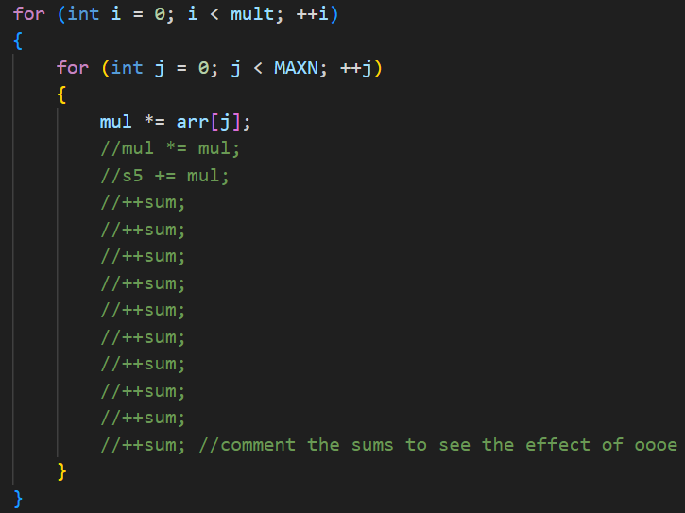
Testing x86 oooe is difficult, but here is the code:

Slide 31
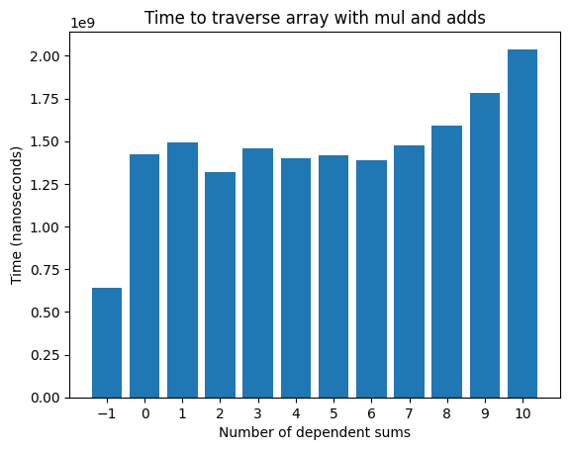
The results show latency hiding

Slide 32
Why act on 1 data per instruction if you can act on multiple?
CPU
Memory:
Instructions
Data
They can add, multiply, shift, etc., 16 integers at a time!

Slide 33
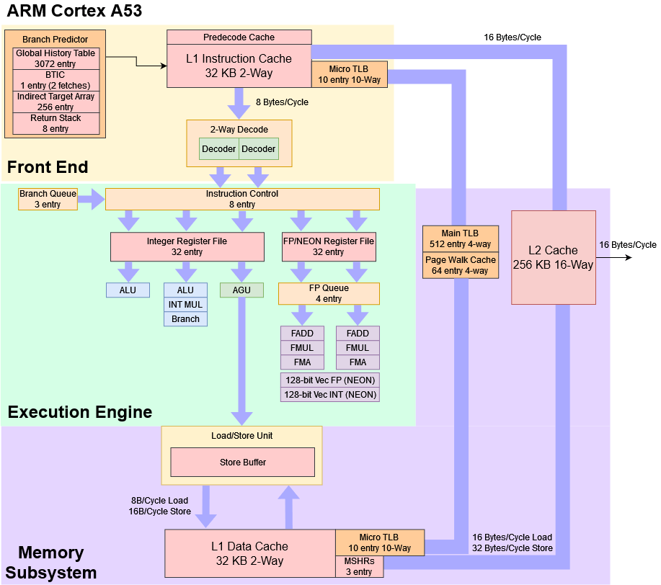
Raspberry pi core has SIMD

Slide 34

Raspberry pi has (somewhat narrow) SIMD; code:
(Compiler optimization)

Slide 35
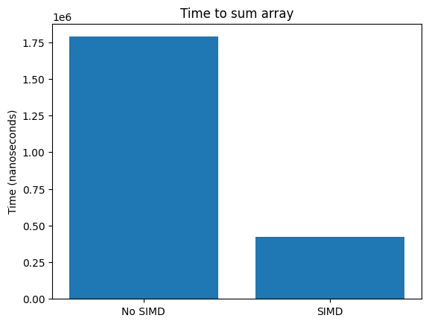
The result is much faster, as expected

Slide 36
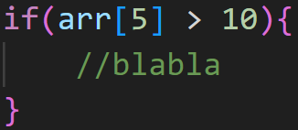
If the data is still in pipeline or underway, what to do? :/
CPU
Memory:
Instructions
Data

Slide 37
Computers just predict where to go next
CPU
?
Memory:
Instructions
Data

Slide 38
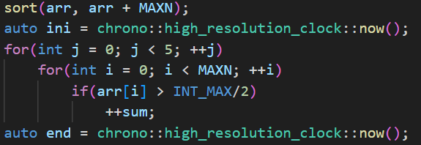
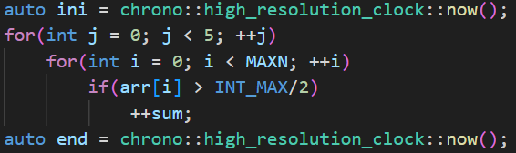
Raspberry pis have very simple branch prediction we test

Slide 39
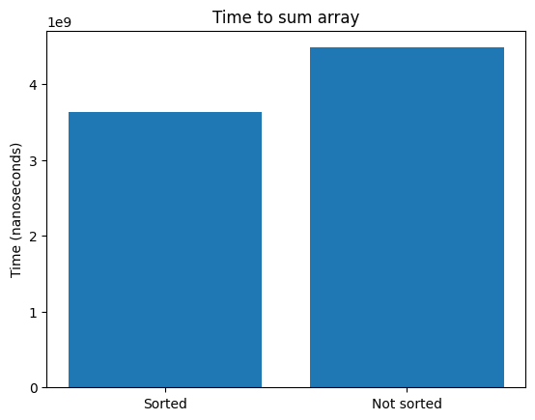
The results are better, but not by much

Slide 40
Conclusions
Engineering computers is very hard
Understanding how computers are engineered is important to performance*
*A lot of optimizations are designed to work seamlessly or are well integrated with compilers
Be aware of them, but trust the compiler!

Slide 41
Your turn!
You are each given an ordered set of computer instructions
A X <-- Y + Z = Add Y and Z and store in X
L X <-- Q = Load computer memory from Q and store in X
S X = Store the value of X somewhere in memory
The computer has
Decode width 2
3 Pipeline stages: fetch, decode, execute
2 ALUs
2 Load execution units
2 Store execution units
Find the most efficient way to reorder the commands, without changing the result. Equal registers cannot be used simultaneously by different instructions

